Slide 1
Input and Output

Slide 2
Input-Output Organization
Peripheral Devices: Input & Output devices attached to computer are called Peripheral.
Input and output devices communicate alphanumeric information by using ASCII 7bit code.
To use computer efficiently, large number of programs and data must be prepared in advance for execution with computer.
I/O interface provides a method for transferring information between internal storage and external I/O devices.
.

Slide 3
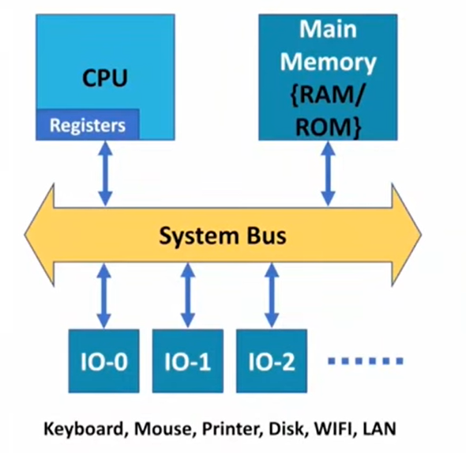
Input-Output Organization

Slide 4
Input-Output Interface
The purpose of interfacing are as follows:
Peripherals are electromechanical & electromagnetic devices and are interacting with electronics devices(CPU).
Data transfer rate of peripherals is usually slower than transfer rate of CPU.
Data codes and formats in peripherals differ from word format in CPU
Operating modes of peripherals are different from each other and each one must be controlled without disturbing other.

Slide 5
Input-Output Interface
To resolve these differences, computer system includes Interface units between CPU and peripherals to supervise and synchronize all input and output transfers.
Each peripheral has its own controller that operates a particular electromechanical device.
To communicate with a particular device, the processor places a device address on the address lines.

Slide 6
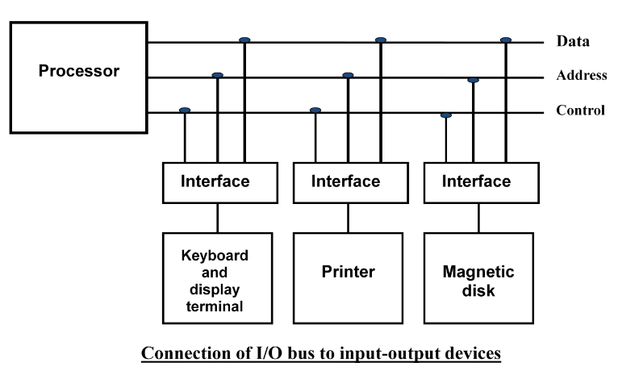
Input-Output Interface

Slide 7
Input-Output Interface
When the interface detects its own address, it activates path between bus lines and the device.
At the time address is made available in address lines, the processor provides function code(I/O command) in the control lines.
Types of I/O command:
Control command: To activate and inform what to do.
Status command: To test various status conditions.
Data Output command: It causes the transfer of data from bus into one of its registers.
Data Input Command: Interface receives data from peripheral and places them on buffer register where it is put into data lines.

Slide 8
I/O versus Memory Bus
In addition to communicating to I/O, processor must also communicate with memory unit.
There are three ways that computer buses can be used to communicate with memory and I/O:
Use two separate buses, one for memory and one for I/O. (IOP)
Use one common bus for both memory and I/O but have separate control lines for each. (Isolated I/O)
Use one common bus for memory and I/O with common control lines. (Memory Mapped I/O)

Slide 9
Input-Output Transfer (IOP)
An IOP takes care of input and output tasks.
The CPU is assigned the task of initiating all operations, but I/O instructions are executed in IOP.
When an I/O operation is required, the CPU informs the IOP where to find the I/O program and then leaves the transfer details to the IOP.
IOP is also responsible of taking care of data synchronization, formats etc between CPU and I/O devices. In most computers CPU is master and IOP is slave.

Slide 10
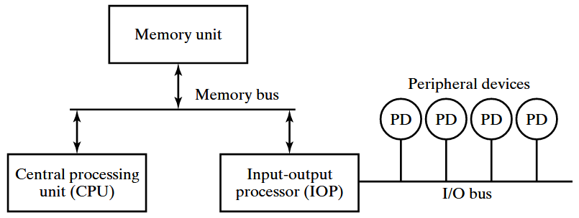
Input-Output Transfer (IOP)

Slide 11
Isolated I/O
The distinction between memory and I/O transfer is made through separate read and control lines.
I/O read, and I/O write are enabled during I/O transfer and Memory read/write are enabled during memory transfer.
In the isolated I/O configuration, CPU have distinct input and output instructions where each of it will be associated with address of the interface register.
When the CPU fetches and decodes the I/O instruction, it places the address associated with the instruction on the common address lines and enables I/O read or I/O write control line.

Slide 12
Isolated I/O
When the CPU fetches and decodes the Memory instruction, it places the address associated with the instruction on the common address lines and enables Memory read or Memory write control line.
The isolated I/O method isolates memory and I/O addresses.

Slide 13
Memory Mapped I/O
In this configuration, same address space is used for both memory and I/O.
The computer treats interface register (I/O) as a part of memory system.
The assigned address cannot be used for storing memory words, which reduces memory address range available.
In a memory-mapped I/O organization, there are no specific, input or output instruction.
CPU manipulate I/O data residing in interface registers with the same instruction used to manipulate memory words.

Slide 14
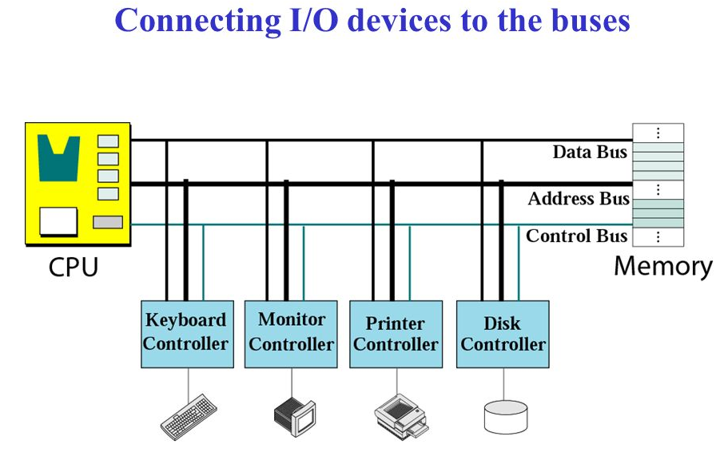
Memory Mapped I/O

Slide 15
Modes of Transfer
Data transfer between the CPU and the I/O devices may be handled in variety of modes. Some modes use the CPU as an intermediate path and others transfer the data directly to and from the memory unit.
Data transfer to and from peripherals may be handled in three ways:
Programmed I/O
Interrupt-initiated I/O
Direct Memory Access (DMA)

Slide 16
Programmed I/O
Programmed I/O operations are the result of I/O instructions. Each data item transfer is initiate by an instruction in the program.
Usually, the transfer is to and from a CPU register and peripheral. Other instructions are needed to transfer data between memory and CPU.
Once a data transfer is initiated, the CPU is required to monitor the interface to see when a transfer can again be made.

Slide 17
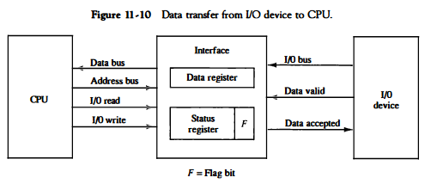
Programmed I/O

Slide 18
Interrupt Initiated I/O
In the programmed I/O CPU stays in program loop until the I/O indicates that it is ready for data transfer.
This is time consuming process since it makes CPU busy needlessly.
This can be avoided by using an interrupt facility.
When the interface determines that device is ready for data transfer, it generates an interrupt request.
Upon detecting external interrupt signal, the CPU momentarily stops the task it is processing.
It then branches to fulfill the I/O request and return to the original task.

Slide 19
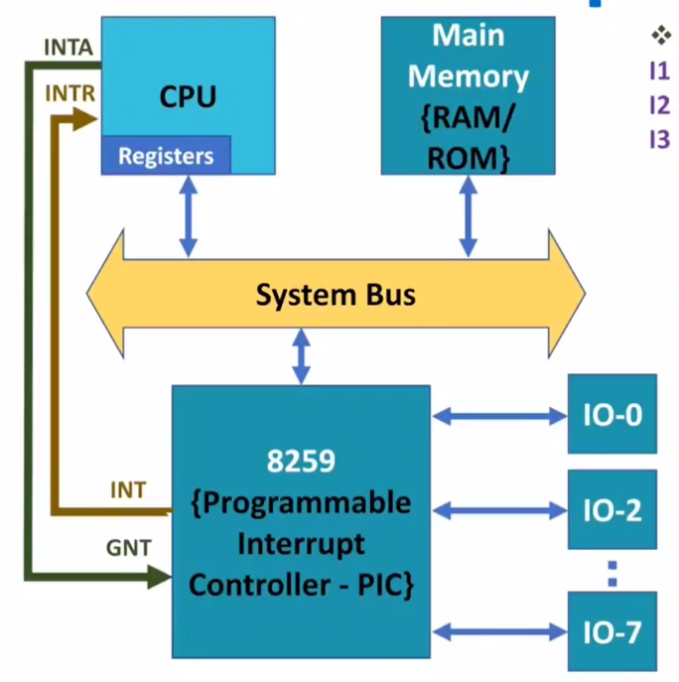
Interrupt Initiated I/O

Slide 20
Direct Memory Access (DMA)
The transfer of data between a fast storage device such as magnetic disk and memory often limited to the speed of CPU.
Removing the CPU and letting the peripheral device manage the memory bus directly improve speed of transfer.
Such transfer technique is called Direct Memory Access (DMA).
A DMA controller takes over the buses to manage the transfer directly between I/O device and memory.
During DMA transfer, the CPU is idle and has no control over memory buses.
By using Bus Request(BR) and Bus Grant(BG) the buses are released to DMA controller.

Slide 21
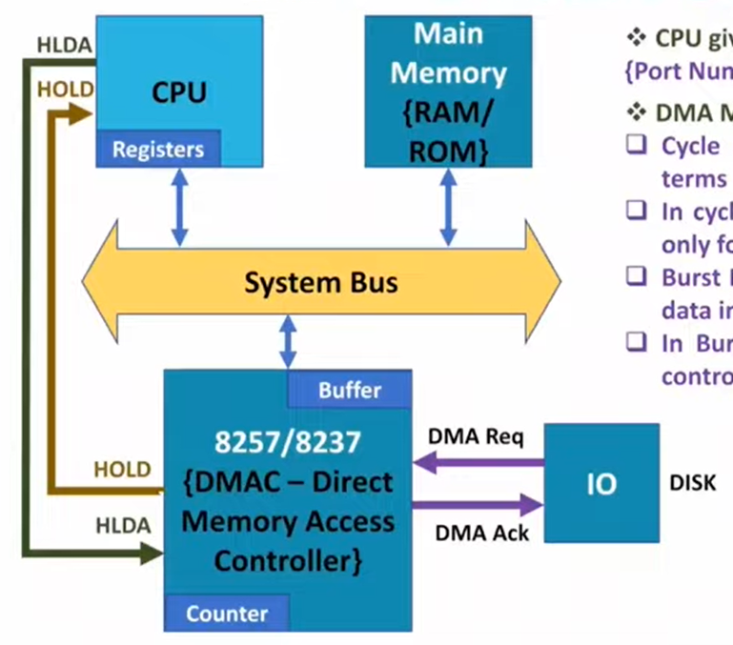
DMA

Slide 22
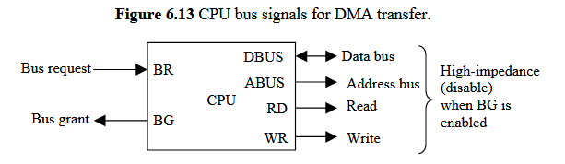
DMA
Data transfer ways:
Burst Transfer: Here number of words are transferred in a block. Example: Magnetic disk.
Cycle stealing: Allows the DMA controller to transfer one data word at a time after it must return the control of buses to CPU.

Slide 23
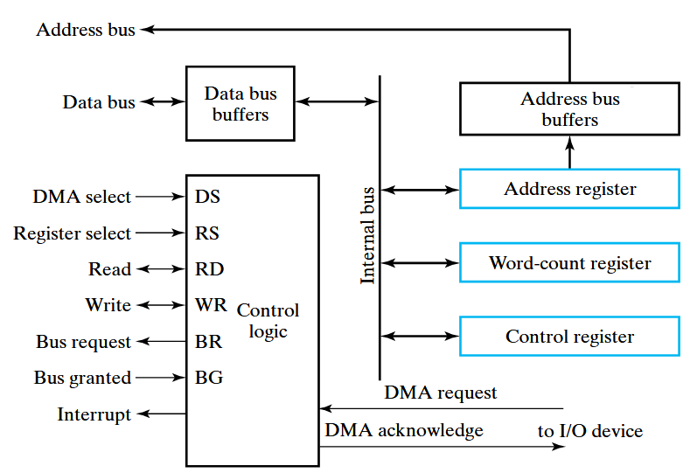
DMA Controller

Slide 24
Initialization of DMA
The CPU initializes the DMA by sending the following information through the data bus.
The starting address of the memory block where data are available(for read) or where data are to be stored(for write).
The word count, which is the number of words in the memory block.
Control to specify the mode of transfer such as read or write.
A control to start the DMA transfer.

Slide 25
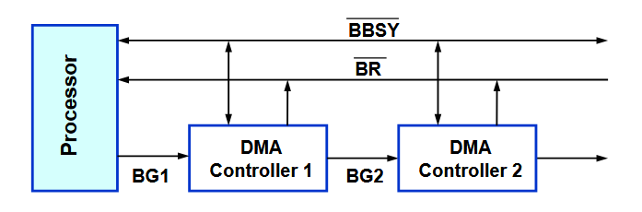
Bus Arbitration
The device that is allowed to initiate data transfers on the bus at any given time is called Bus master.
Bus arbitration is the process by which the next device becomes Bus master and will do the data transfer.
Two approaches: Centralized Arbitration and Distributed Arbitration.

Slide 26
Interrupt
An interrupt in a system is a signal that causes the computer to stop its current task and perform a predefined routine called an interrupt handler.
Types of Interrupt are:
External Interrupt: It comes from I/O devices, from timing device, or from any other external source.
Internal Interrupt: It includes register overflow, invalid operation code, stack overflow etc.
Software Interrupt or Hardware Interrupt: External and Internal interrupts are initiated from signals that occur in the hardware of the CPU. A software interrupt is initiated by executing an instruction.

Slide 27
Types of Interrupt
Maskable and Non-maskable Interrupt: An interrupt that can be disabled or ignored by the instructions of CPU are called as Maskable Interrupt. The interrupt that can not be disabled or ignored are called as Non-Maskable Interrupt. .
Priority Interrupt: In case several sources will request service simultaneously, in this case system must decide which device to service first. For ex: Polling, Daisy Chain.

Slide 28
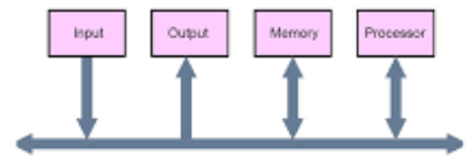
Buses
Data Bus: Bi-directional and transfers data.
Address Bus: Uni-directional and sends the address.
Control Bus: R/W, BR,BG etc.
Bus Structure: Single bus

Slide 29
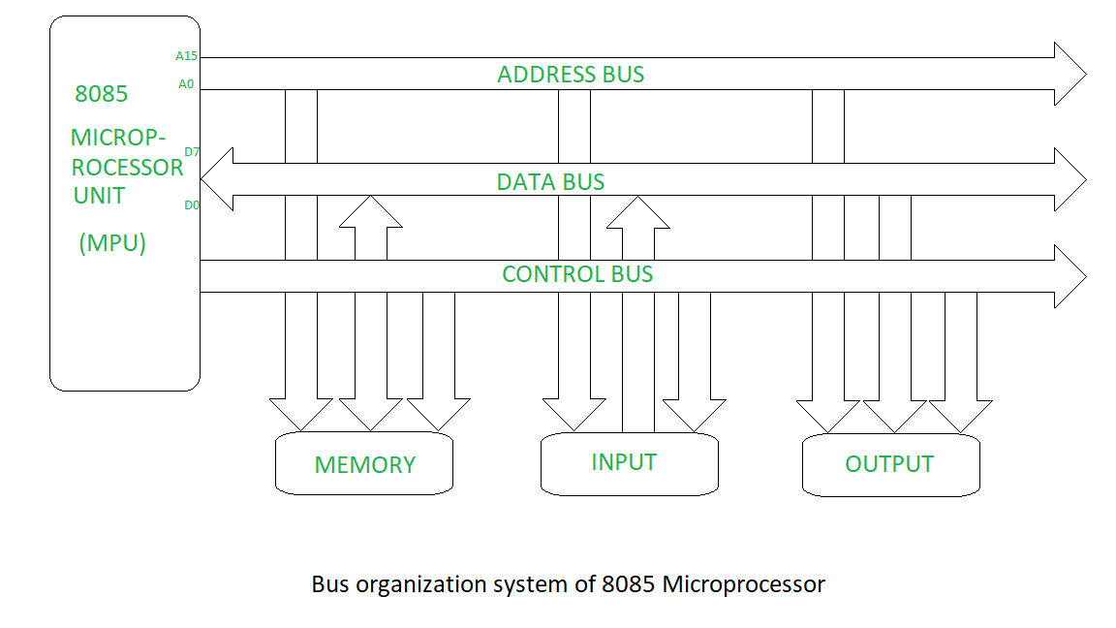
Buses

Slide 30
Synchronous or Asynchronous Data Transfer
Internal operations in a digital system are synchronized by means of clock pulses supplied by common pulse generator.
If the registers in the interface share a common clock with the CPU registers, the transfer is synchronous.
Asynchronous data transfer requires that control signals be transmitted between communicating units to indicate the time at which data is being transmitted.
Asynchronous data transfer can be accomplished by Strobe & Handshaking.

Slide 31
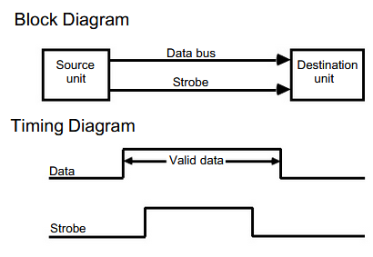
Strobe Control
Strobe control:
It employs single control line to time for each transfer.
It can be activated either by source or destination unit.
Disadvantage:
No Acknowledgement

Slide 32
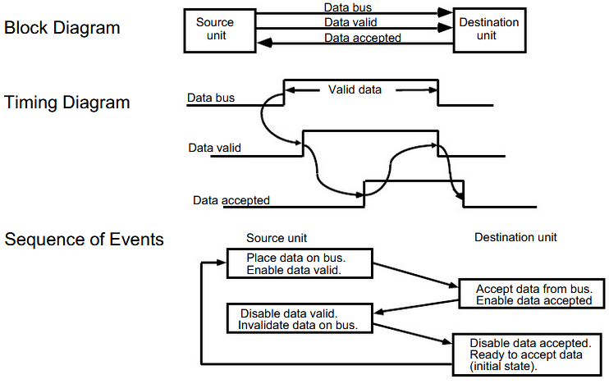
Handshaking

